Slide 1
AUDIO DEEPFAKE DETECTION USING MACHINE LEARNING

Slide 2
Abstract
The Deepfake Audio Detector with XAI is a cutting-edge project focused on detecting deepfake audio using advanced neural network architectures like VGG16, MobileNet, ResNet, and custom CNNs. By converting audio into spectrograms, it enhances feature extraction for improved model performance. The integration of Explainable AI (XAI) techniques such as LIME, Grad-CAM, and SHAP ensures transparency and trust in model predictions. A comparative analysis of model accuracy and explainability guides optimal detection strategies. The project offers a user-friendly interface via Streamlit, addressing real-world challenges in combating audio-based misinformation and fraud.

Slide 3
Introduction
The rise of deepfake technology has introduced significant challenges, particularly in distinguishing authentic audio from manipulated content. This project, Deepfake Audio Detector with XAI, leverages state-of-the-art deep learning models like VGG16, MobileNet, and ResNet to detect deepfake audio effectively.
By converting audio files into spectrograms, it extracts detailed features to enhance detection accuracy. Explainable AI (XAI) techniques such as LIME, Grad-CAM, and SHAP provide insights into model decisions, fostering transparency and trust. The project’s accessible deployment through Streamlit ensures practical applications in combating audio-based fraud and misinformation.

Slide 4
Existing System
Existing deepfake audio detection systems often rely on traditional machine learning models or basic neural networks that lack robustness in handling diverse audio manipulations. They generally focus on raw audio features, which may not capture intricate patterns present in deepfake samples.
Most systems provide limited interpretability, leaving users uncertain about how predictions are made. Additionally, these solutions typically lack user-friendly interfaces, making them inaccessible for broader audiences. Such limitations highlight the need for advanced, explainable, and interactive detection frameworks like the one proposed in this project.

Slide 5
Proposed System
The proposed system introduces an advanced deepfake audio detection framework leveraging state-of-the-art neural network architectures like VGG16, MobileNet, ResNet, and custom CNNs for superior classification accuracy. Audio data is processed into spectrograms to capture detailed time-frequency features, enhancing model performance.
Explainable AI (XAI) techniques, including LIME, Grad-CAM, and SHAP, are integrated to provide transparency and insights into the model's predictions. A user-friendly interface, built using Streamlit, ensures accessibility for diverse users, from researchers to professionals combating audio-based fraud. This system addresses the limitations of existing solutions by offering a robust, interpretable, and deployable deepfake audio detection tool.

Slide 6
LITERATURE REVIEW
The detection of deepfake audio has evolved from traditional methods relying on statistical features to advanced neural networks like CNNs for analyzing spectrograms. While these models improve accuracy, they often lack interpretability, making Explainable AI (XAI) techniques like LIME, SHAP, and Grad-CAM increasingly relevant. Current systems struggle with robustness and generalization to diverse manipulations.
Additionally, most lack accessible user interfaces, limiting their practical application. This project addresses these gaps by integrating cutting-edge detection models with XAI and deploying them through a user-friendly interface.

Slide 7
Modules and Algorithms Used
Data Preprocessing Module: Converts raw audio into spectrograms for feature-rich input to deep learning models.
Deep Learning Models Module: Utilizes architectures like VGG16, MobileNet, ResNet, and custom CNNs for audio classification.
XAI Module: Employs LIME, Grad-CAM, and SHAP to provide explanations and insights into model predictions.
Evaluation and Analysis Module: Performs comparative analysis of model accuracy and explainability metrics.
Web Deployment Module: Implements Streamlit for building an interactive, user-friendly web application interface.

Slide 8
Software Components:
python
anaconda
Ml algoritms
Deep learning
Matplotlib
NumPy
Hardware Components:
Camera/Camera Module
GPU (Graphics Processing Unit)
CPU (Central Processing Unit)
RAM (Random Access Memory)
Storage
Edge Device (Optional)
Power Supply

Slide 9
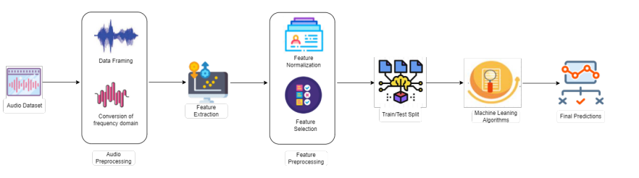
Block Diagram

Slide 10
UML Diagrams
Use Case Diagram
Data Flow Diagram
Sequence Diagram
State Diagram

Slide 11
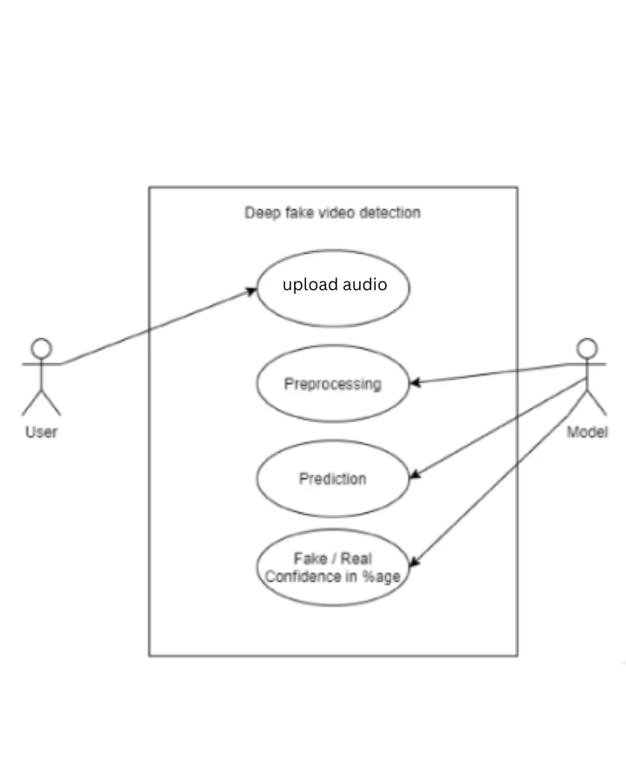
Usecase Diagrams

Slide 12
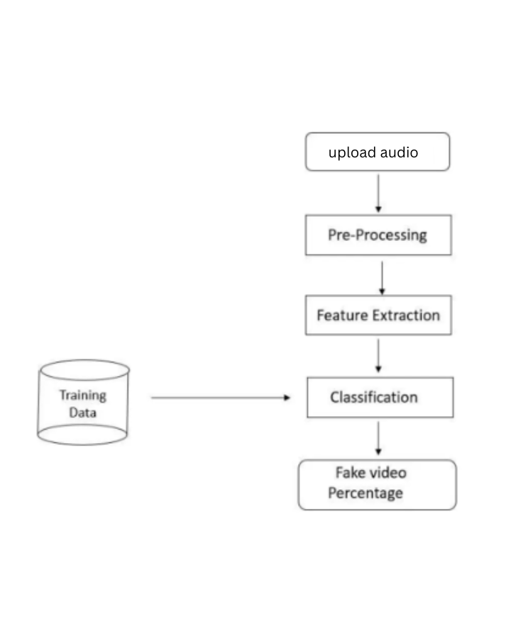
Data Flow Diagrams

Slide 13
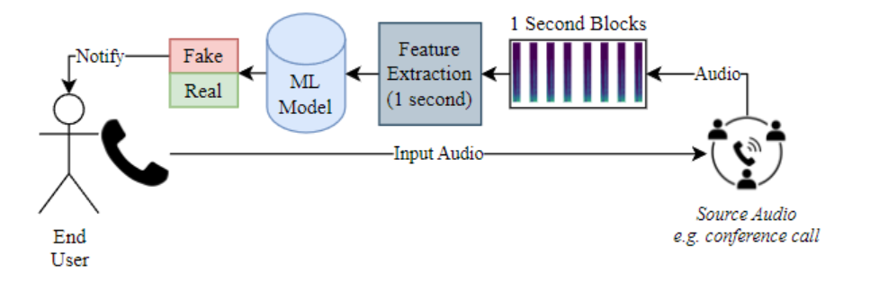
Active Diagrams

Slide 14
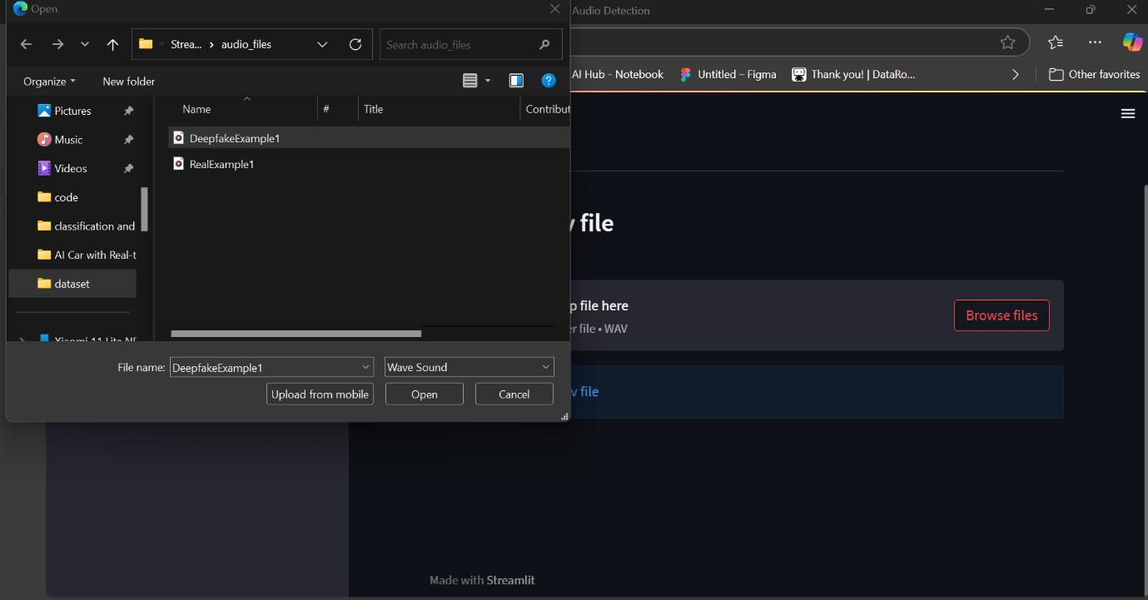
Final Output
The system outputs the classification result, indicating whether the audio is real or deepfake, along with a confidence score. Additionally, it provides visual explanations (e.g., Grad-CAM heatmaps) to highlight features influencing the model’s decision. The user-friendly interface presents results in an accessible format, ensuring clarity and interpretability.

Slide 15
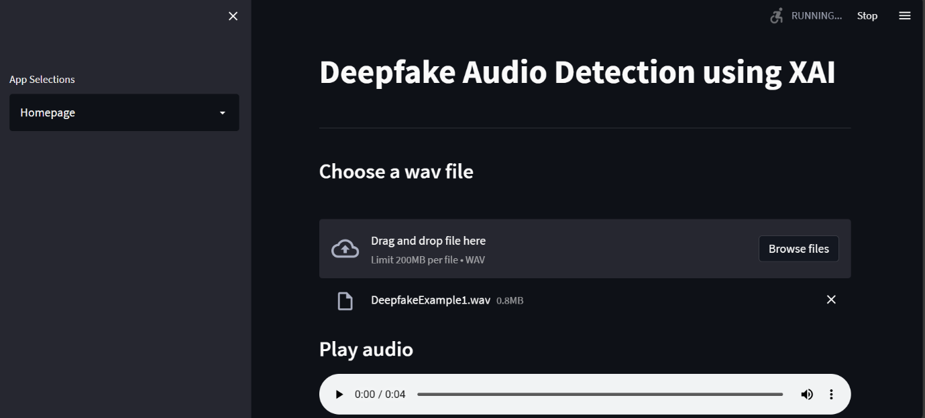
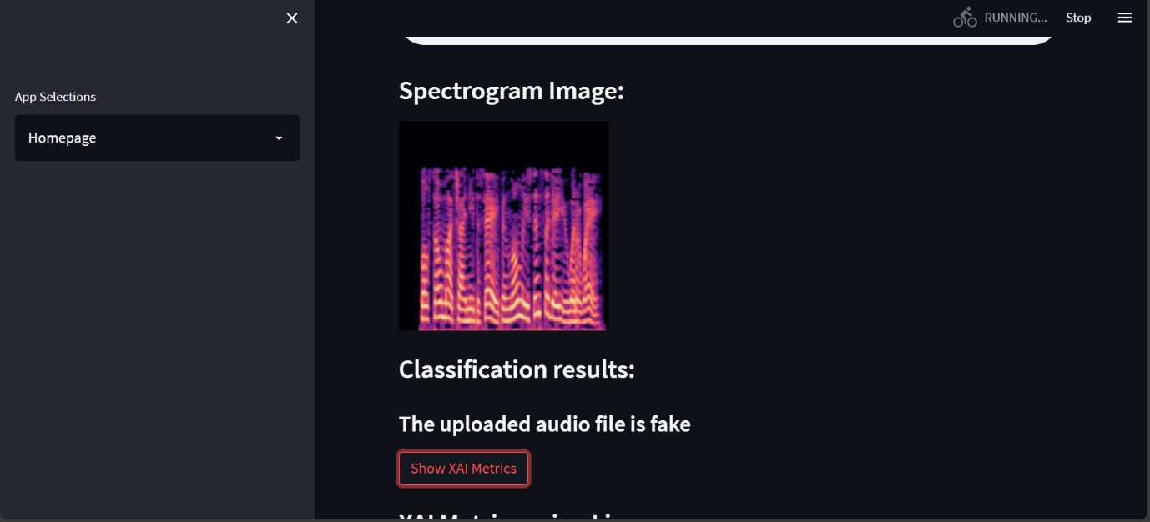
Final Output

Slide 16
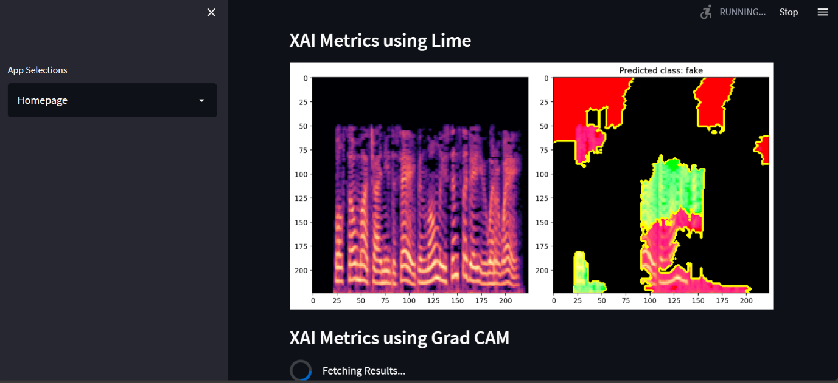
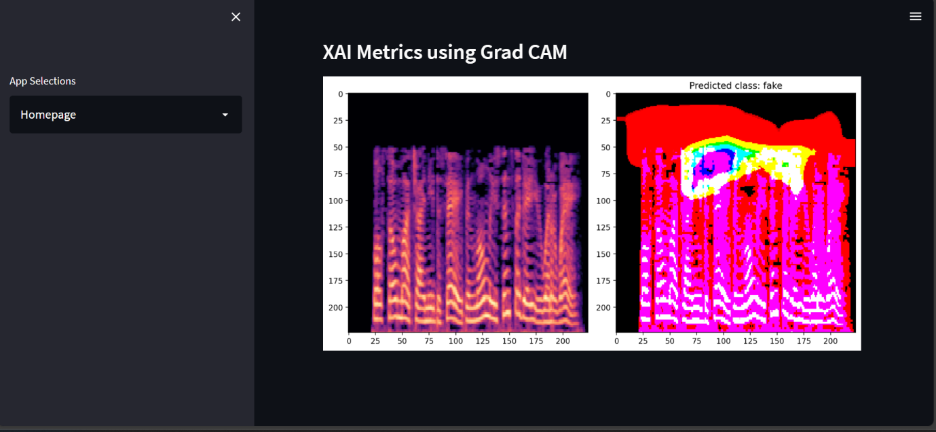
Final Output

Slide 17
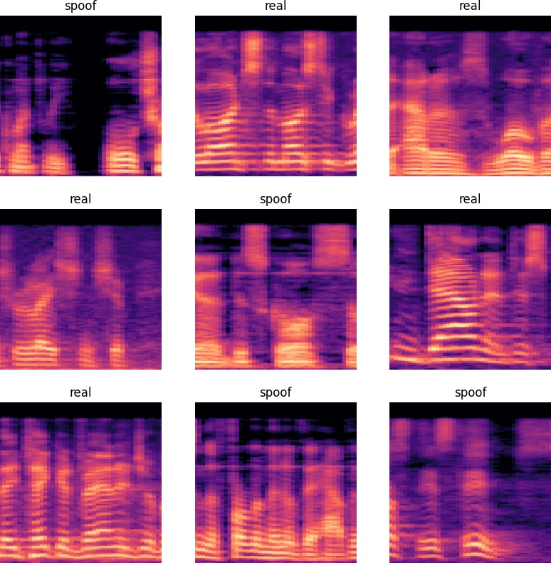
Final Output

Slide 18
Conclusion
In conclusion, the Deepfake Audio Detector with XAI provides an advanced solution to detecting synthetic audio using powerful neural network models and spectrogram-based features. The integration of Explainable AI techniques enhances transparency, making model predictions more interpretable. By offering a comparative analysis of different models, the system ensures optimal performance and accuracy. The user-friendly web interface ensures accessibility, making this tool a practical solution for combating audio-based misinformation and fraud.

